Slide 1

Predictive Analytics
Used Car Price Prediction
Final Project
Presented By:
Gitesh Poudel

Slide 2

Data Set
Craigslist is one of the largest marketplace for used car sales
Dataset used in this project includes every used vehicle entry within the United States on Craigslist
Dataset is part of Monthly Scrapping Project hosted in Kaggle and GitHub
Dimension of dataset:
Rows : 423,857
Columns : 25
Target variable:
Price of Vehicle
Attributes of each vehicle advertisement record includes year of manufacture, odometer reading, manufacturer, model, type, drive, transmission, fuel type, county, region, state, etc.

Slide 3

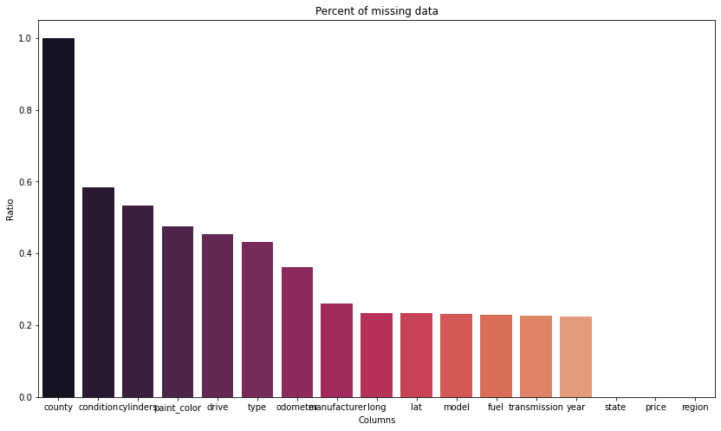
Challenges and Remedies
30% Missing Values
27042 unique car models
Outliers in Odometer reading and price
Technique used to tackle challenges
Missing values
Records missing all three important feature year, model and odometer was dropped
Missing odometer reading replaced by average odometer of respective year
Rest of the missing value replaced with respect to corresponding model of car, adopted mode for categorical value, mean for numerical value
Outliers has been removed from dataset by using quantile technique.
Unrealistic Price and odometer reading are removed.
Models has been standardized to 160 car models by filtering out model with less frequency in dataset.

Slide 4
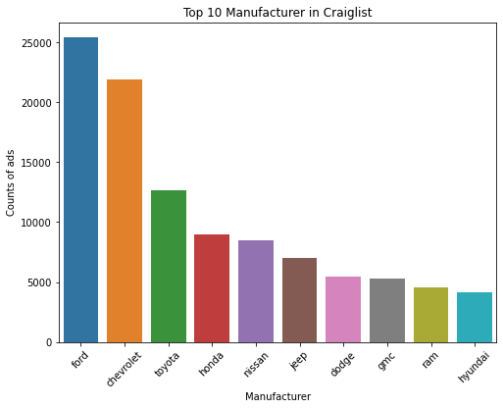
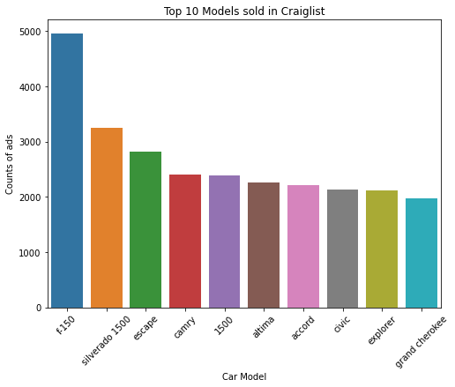
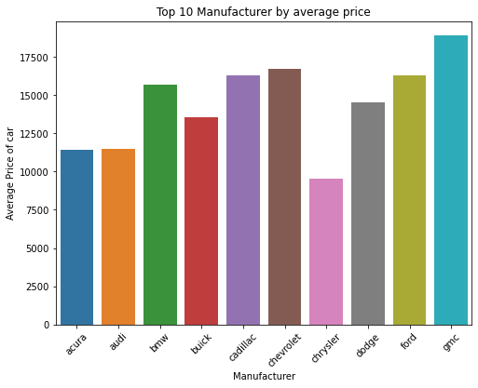
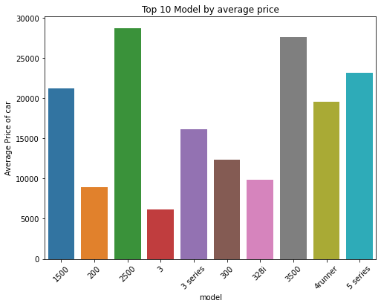

Visual Exploratory Analysis

Slide 5

Model Selection
Since, the target “price” is continuous value, we will be using regression models
Multivariate Linear Regression: Making prediction based on linear relationship of feature variable with price of car.
Library: Scikit-learn
KNN Regressor: Predicting based on closest neighbor.
Library: Scikit-learn
Gradient Boosting: Boosted tree algorithm to train an ensemble model which uses gradient descent to minimize the error.
Library: XGBOOST

Slide 6


Encoding and Scaling
Encoding
Most of the feature variables in dataset are categorical and must be changed to Numerical before modeling
Encoding Options:
One Hot encoding
Label Encoder
Scaling
Numerical variables relatively different range of data distribution, this could impact the training of model.
Scaling Options:
Standard Scaler
Min Max Scaler

Slide 7



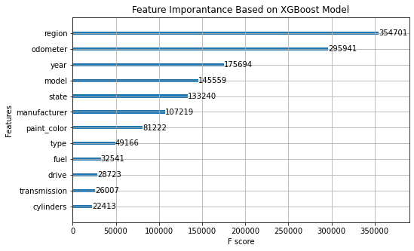
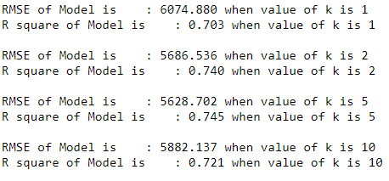
Model Evaluation
Dataset was divided into Training and Testing set by 7:3 ratio, below evaluation are based Testing set
Multivariate Linear Regression:
Gradient Boosting
KNN Regressor:

Slide 8
Conclusion
Improvement ideas:
Few more feature engineering can be done from some of the dropped features such as condition, size, title status.
Vehicle model feature can be perfected well to improve the accuracy of prediction model.
Application of this predictive model
Fitted model can be used in a web app for people to estimate the resale value of their vehicle
Craigslist can utilize model to advise range of car resale value to their user posting in advertisement.

Slide 9
References
Data source:
https://www.kaggle.com/austinreese/craigslist-carstrucks-data
Original Scrapping Project:
https://github.com/AustinReese/UsedVehicleSearch
Thank You

